Slide 1
UDEMY COURSES
EXPLORATORY DATA ANALYSIS

Slide 2
OUTLINE
UDEMY COURSES
Understanding and cleaning the data
QUESTIONS FOR ANALYSIS
Visualisations
Insights from the visualisations

Slide 3
UDEMY COURSES
Udemy is a massive online open course (MOOC) platform that offers both free and paid courses. Anybody can create a course, a business model by which allowed Udemy to have hundreds of thousands of courses.

Slide 4
Understanding and cleaning the data
There are 3678 rows and 12 columns
There are no missing values in this data set
There are four Different subjects offered.
The price ranges for the various courses is from 0 to 200.
The courses are both paid or unpaid.
The subjects may be all levels, beginner, intermediate or expect level.

Slide 5
QUESTIONS FOR ANALYSIS
How many courses are in each subject category?
How many courses are in each level type?
how many people have subscribed to the various subjects?
How much sales was made per subject?
How many subscribers does each level have?
Does the number of reviews influence the number of subscribers?
Does price influence the number of subscribers?

Slide 6
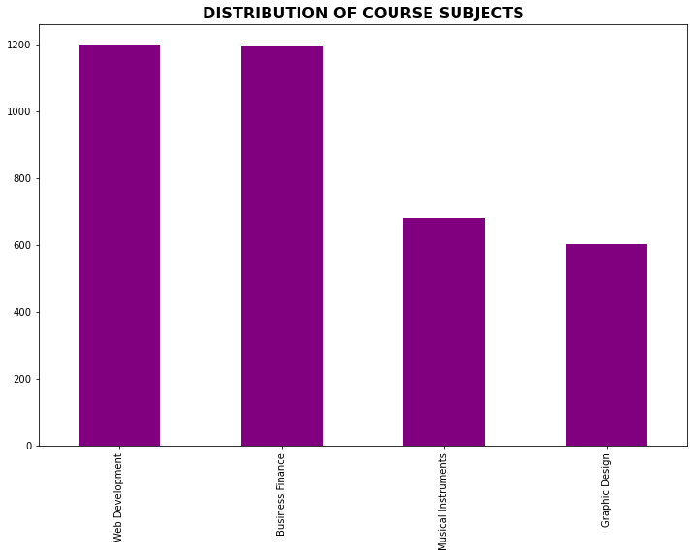
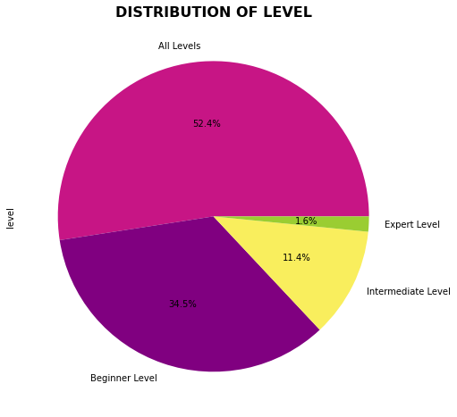
visualisations

Slide 7
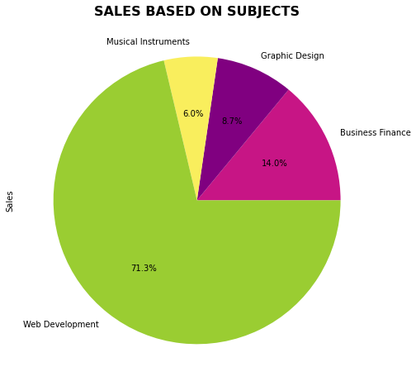
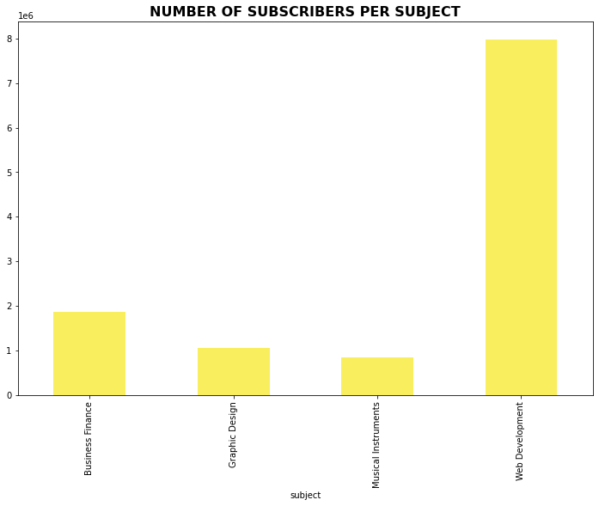
visualisations

Slide 8
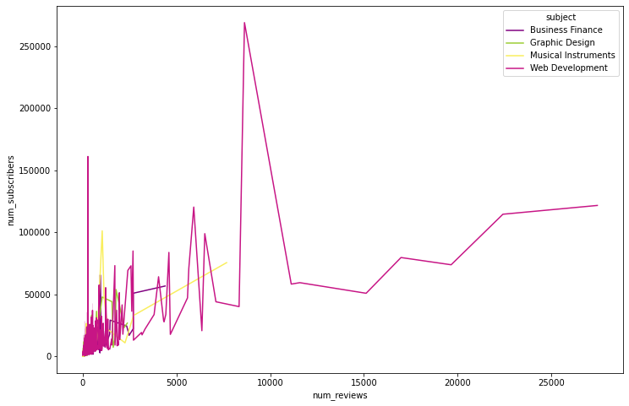
visualisations

Slide 9
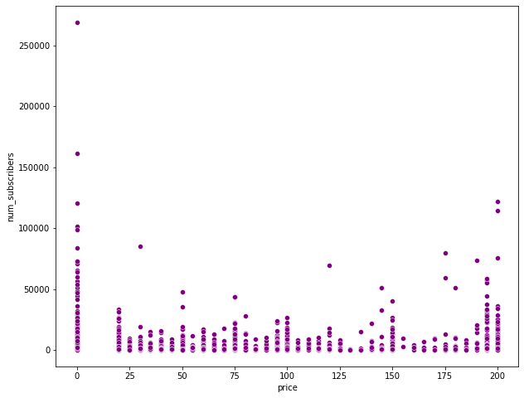
visualisations

Slide 10
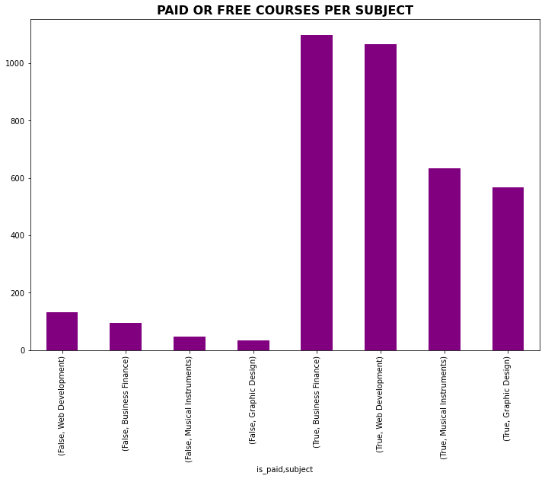
visualisations

Slide 11
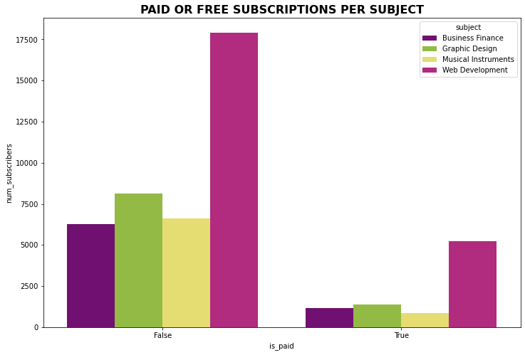
visualisations

Slide 12
Insights from the visualisations
Most of the courses offered by Udemy are under web development whilst graphic design has the least number of courses.
52.4% of all the courses offered runs fr0m the beginner level to the advanced level. 1.6% of the courses offered focus only on the expert level.
Web development has the highest number of subscribers with 7980572 subscribers whilst medical instruments have the least subscribers.
There is some influence made by number of reviews on the number of subscribers. There are more subscribers when reviews are in the ranges of 0 and 10000.

Slide 13
Insights from the visualisations
Prices influence subscription since there are more subscribers when the price is 0 dollar. There is notable amount of subscribers at price 200 dollars since price maybe associated with quality.
since regardless of the course being paid or not web development has more subscribers.

Slide 14
Recommendations
UDEMY should introduce more courses that run from the beginner level to advanced level.
They can also increase the number of web development courses since regardless of the course being paid or not web development has more subscribers.
to increase subscription, udemy should introduce some discount packages on courses with low subscription.

Slide 15
RECOMMENDATIONS
Udemy creates on develops more courses in Web Development since it has more subscribers and brings in the highest sales.
In order to increase subscription with other subject category ,Udemy has to focus on offering most of the courses in all level since most subscribers prefer that.
To increase subscription to the other subject category apart from Web development, they can reduces the price slightly .

